Slide 1
Influence Maximization
Team: Mr. Seedella Sai Vikas(420233)
Mr. Vedagiri Krishna Sandeep(420247)
Mr. Matta Rahul(420206)
Mentor:
Mrs. B.S.S.S. MONICA BANDARU

Slide 2
Problem Statement
To identify a small set of individual nodes in social network, which can have greatest impact on behavior on rest of the network i.e, which can maximize the spread of the influence.

Slide 3
Literature Review
Monotonicity: Monotonicity in influence maximization refers to the property that adding a node to the seed set can only increase the spread of influence in a non-decreasing manner. Submodularity: Submodularity characterizes the diminishing returns property, indicating that the marginal gain of adding a node to a larger seed set decreases as the seed set size increases in influence maximization algorithms.
Influence Maximization : The process of selecting a set of k seed users that will optimally diffuse information through a network.
Seed users : A set of initial users who are used to start the diffusion of information through a network.

Slide 4
Homophily : The tendency of individuals to associate with others who are similar to them.
Structural homophily : The tendency that a node connects to other similar node in the network.
Influence diffusion homophily: The tendency that a node can influence other similar node.
Balance : When categorical ratio between the nodes in the network is preserved in the active set.

Slide 5
Submodularity:
Claim: Hill climbing produces a solution S
where: f(S) ≥(1-1/e)*f(OPT)
(f(S)>0.63*f(OPT))
Claim holds for functions f(·) with 2 properties:
f is monotone: If S ⊆ T then f(S) ≤ f(T) and f({})=0
f is submodular: (activating each additional node helps less) adding an element to a set gives less improvement than adding it to one of its subsets: ∀S ⊆ T
f(S ∪ {u}) – f(S)
Gain of adding a node to a small set
≥
f(T ∪ {u}) – f(T)
Gain of adding a node to a large set

Slide 6
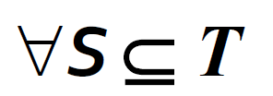
Submodularity – Diminishing Returns
Diminishing returns:
f(·)
″S � T
f(T υ{u})
f(T)
f(S υ{u})
f(S)
Adding u to T helps less than adding it to S!
Set size |T|, |S|
f(S υ {u}) – f(S)
Gain of adding a node to a small set
≥
f(T υ {u}) – f(T)
Gain of adding a node to a large set
Pic Credits: https://snap.stanford.edu/class/cs224w-2019/

Slide 7
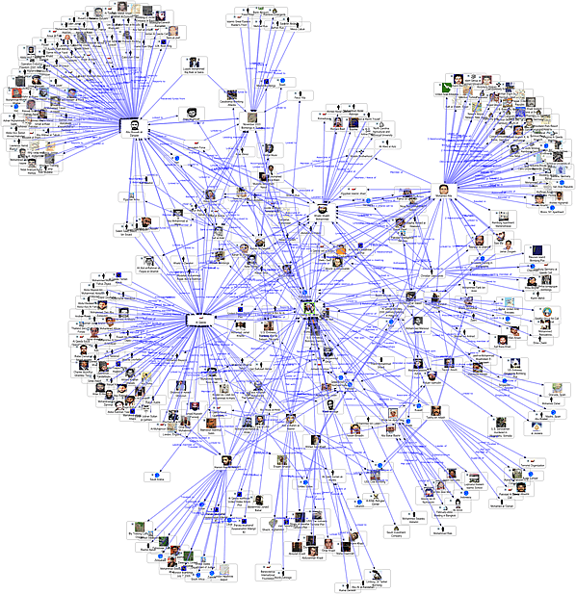
Introduction
Two Classical Diffusion(Propagation) Models
Linear Threshold Model
Independent Cascade Model
Pic Credits: https://snap.stanford.edu/class/cs224w-2019/

Slide 8
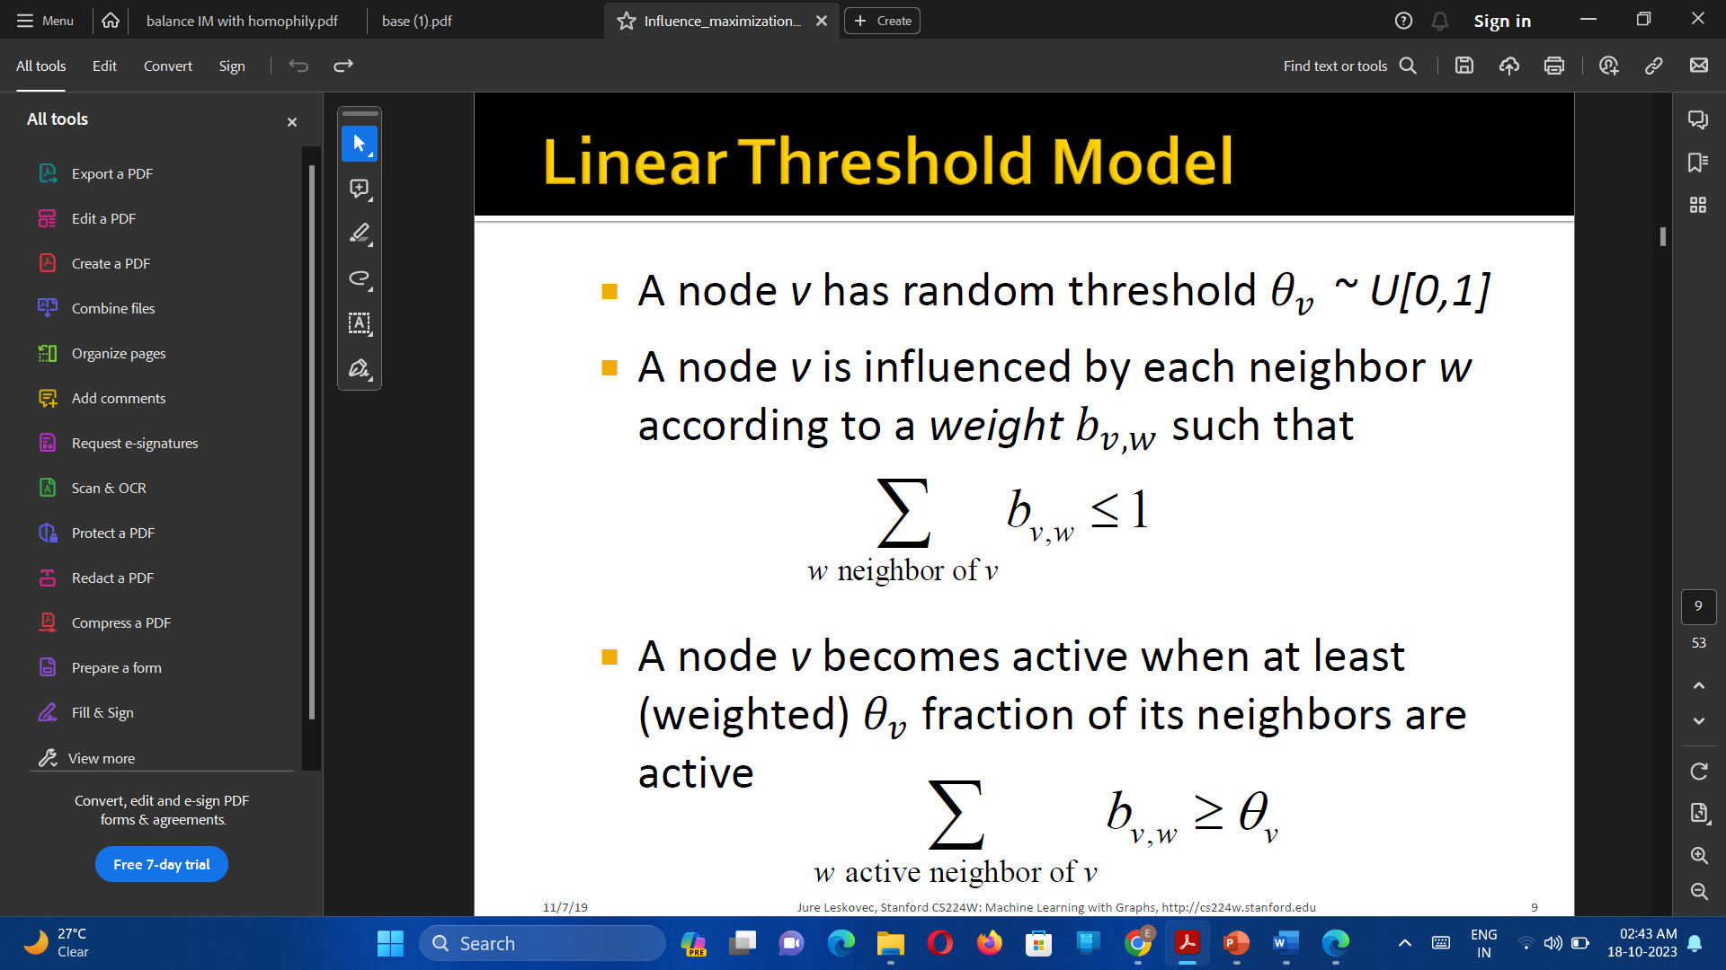

Linear Threshold Model
A node v has random threshold 𝜃" ~ U
A node v is influenced by each neighbor w according to a weight 𝑏",% such that
A node v becomes active when at least (weighted) 𝜃" fraction of its neighbors are active

Slide 9
Each node has a threshold value that represents the minimum level of influence required for the node to become active
The activation process starts with a set of seed nodes that are initially active. At each time step, nodes that have a sufficient level of influence become active and can activate their neighbours. The process continues until no more nodes can be activated.

Slide 10
Independent Cascade Model
Directed finite G = (V,E)
“Set S” starts out with new behavior
Say nodes with this behavior are “active”
Each edge (v, w) has a probability 𝒑_{𝒗𝒘}
If node 𝒗 is active, it gets one chance to make 𝒘 active, with probability 𝒑_{𝒗𝒘}
𝒑_{𝒗𝒘 :} Probability that node 𝒗 can activate node 𝒘
Each edge fires at most once

Slide 11
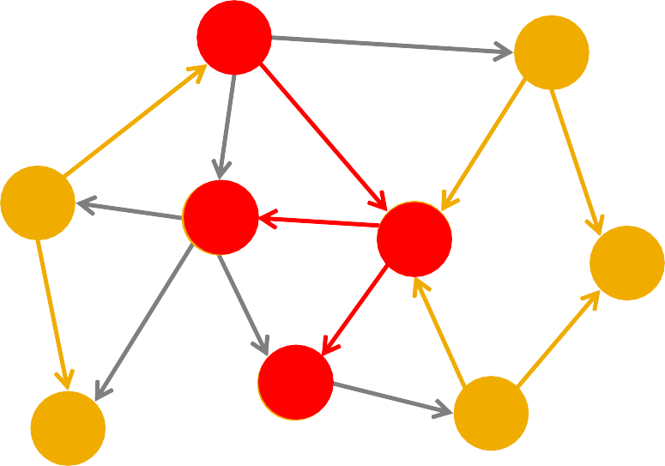
Independent Cascade Model:
Initially some nodes S are active
Each edge (𝒗, 𝒘) has probability (weight) 𝒑_{𝒗𝒘}
a
0.4
d
0.4
0.2
0.3
0.3 0.2
b
f
0.3
0.2
e
0.2
h
0.4
0.4
0.3
0.3
0.3
g
c
0.4
i
When node v becomes active:
It activates each out-neighbor 𝒘 with prob. 𝒑_{𝒗𝒘}
Activations spread through the network
Pic Credits: https://snap.stanford.edu/class/cs224w-2019/
11

Slide 12
Greedy Algorithm
Algorithm : Greedy Algorithm for Influence Maximization
Input: Graph G, Seed Set size K
Output: Seed Set S
1: Start by selecting a small set of seed nodes S.
2: while |S| < K do
3: for each node u not in S do
4: Estimate the expected number of nodes that would be influenced if u is added to S,denoted by f (u).
5: end for
6: Select the node u with the highest value of f (u) and add it to S.
7: end while
8: Return Seed Set S.

Slide 13
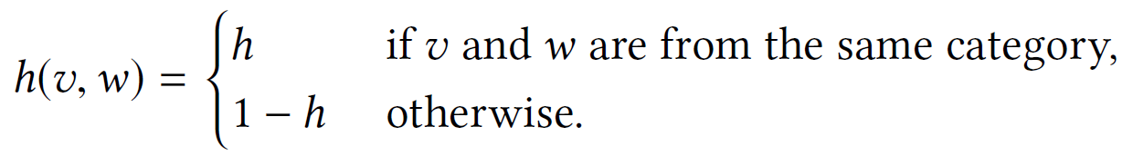
Structural Homophily
A social network phenomenon where individuals who share similar network attributes or structural positions are more likely to form connections or ties with each other.
Network generation model :
Diffusion model:
We use the simple independent cascade model for the influence propagation

Slide 14
How to measure Homophily
Homophily index directly measures the homophily of edges in the network. It is calculated as the ratio of the number of homophilic edges (edges connecting nodes with the same attribute) to the total number of edges.
Homophily Index (h) = 1 – (Sum of edges in similar groups)/(Total Edges)
If h > 1/2 , then we can say that the graph is homphilic
h < 1/2 , then we can say that the graph doesn’t contain homophily.

Slide 15
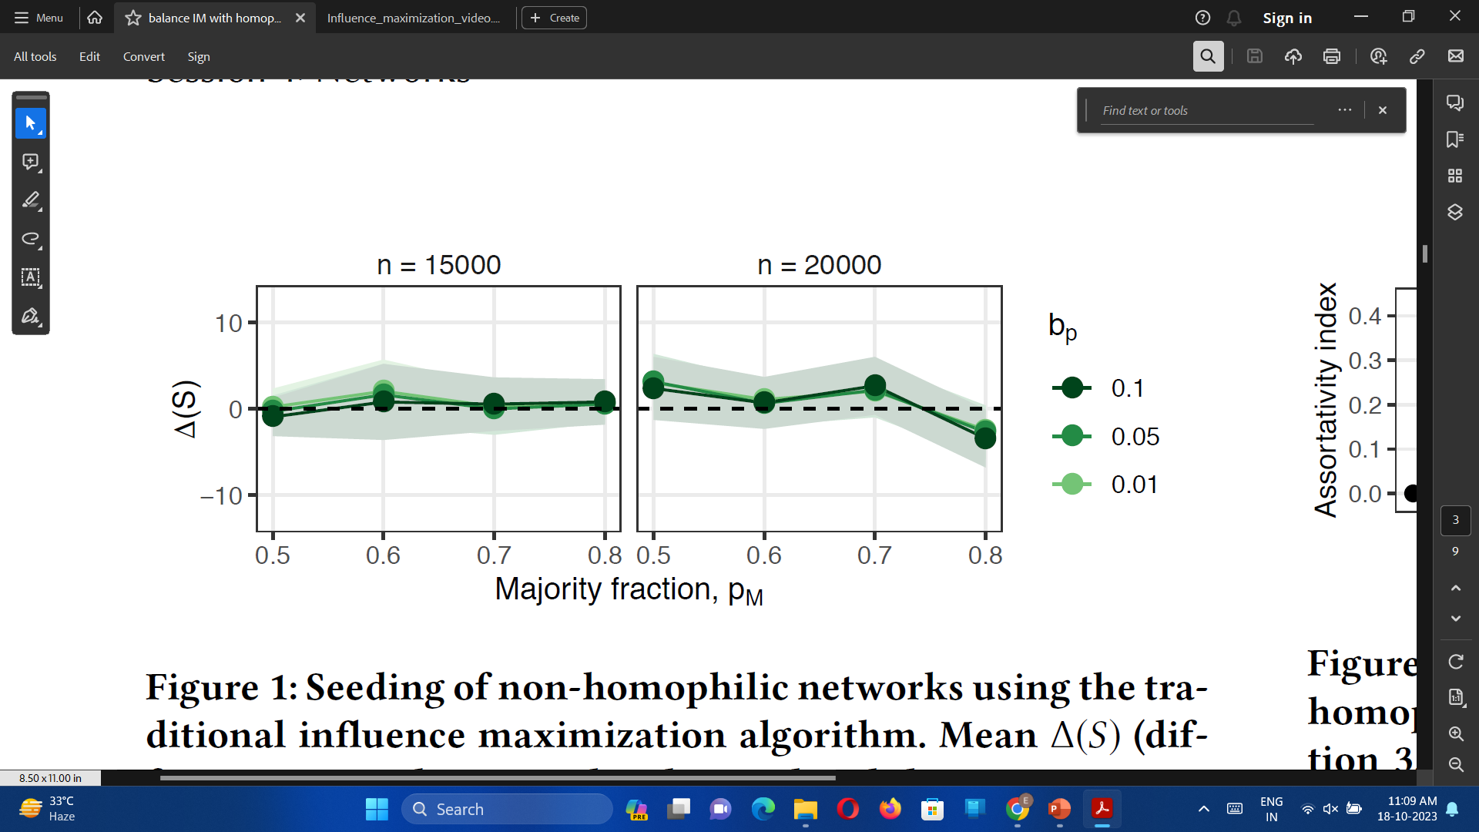
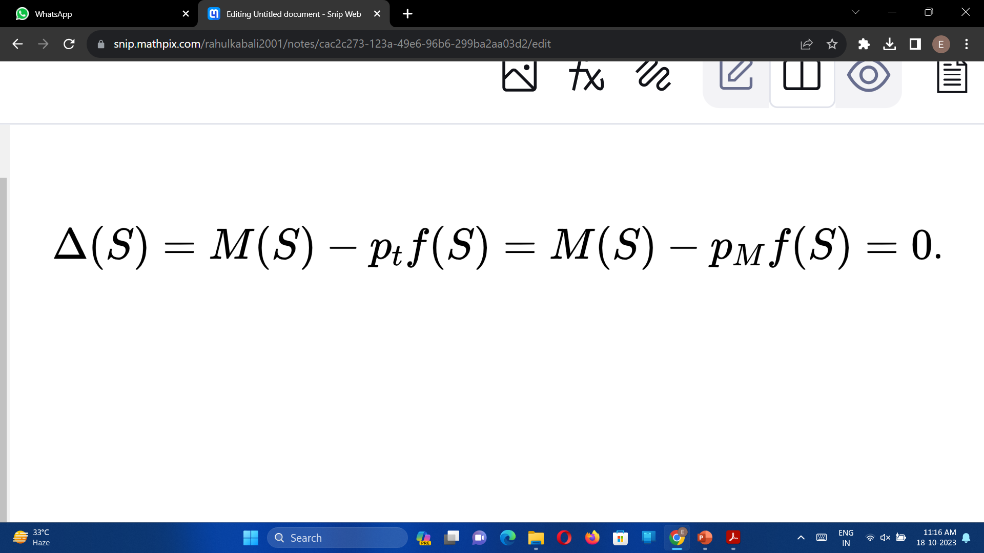
Trade off between Balance and Pm
When can we say it is balanced?

Slide 16
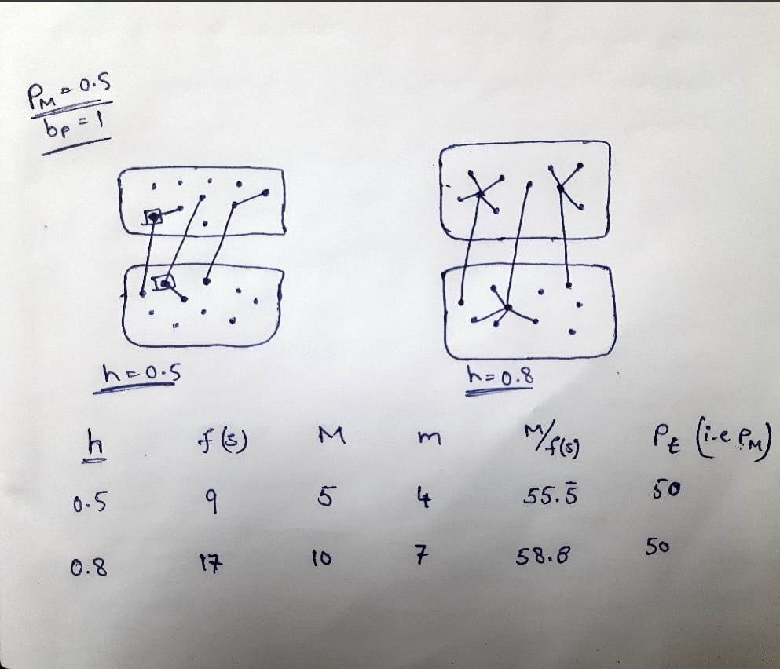
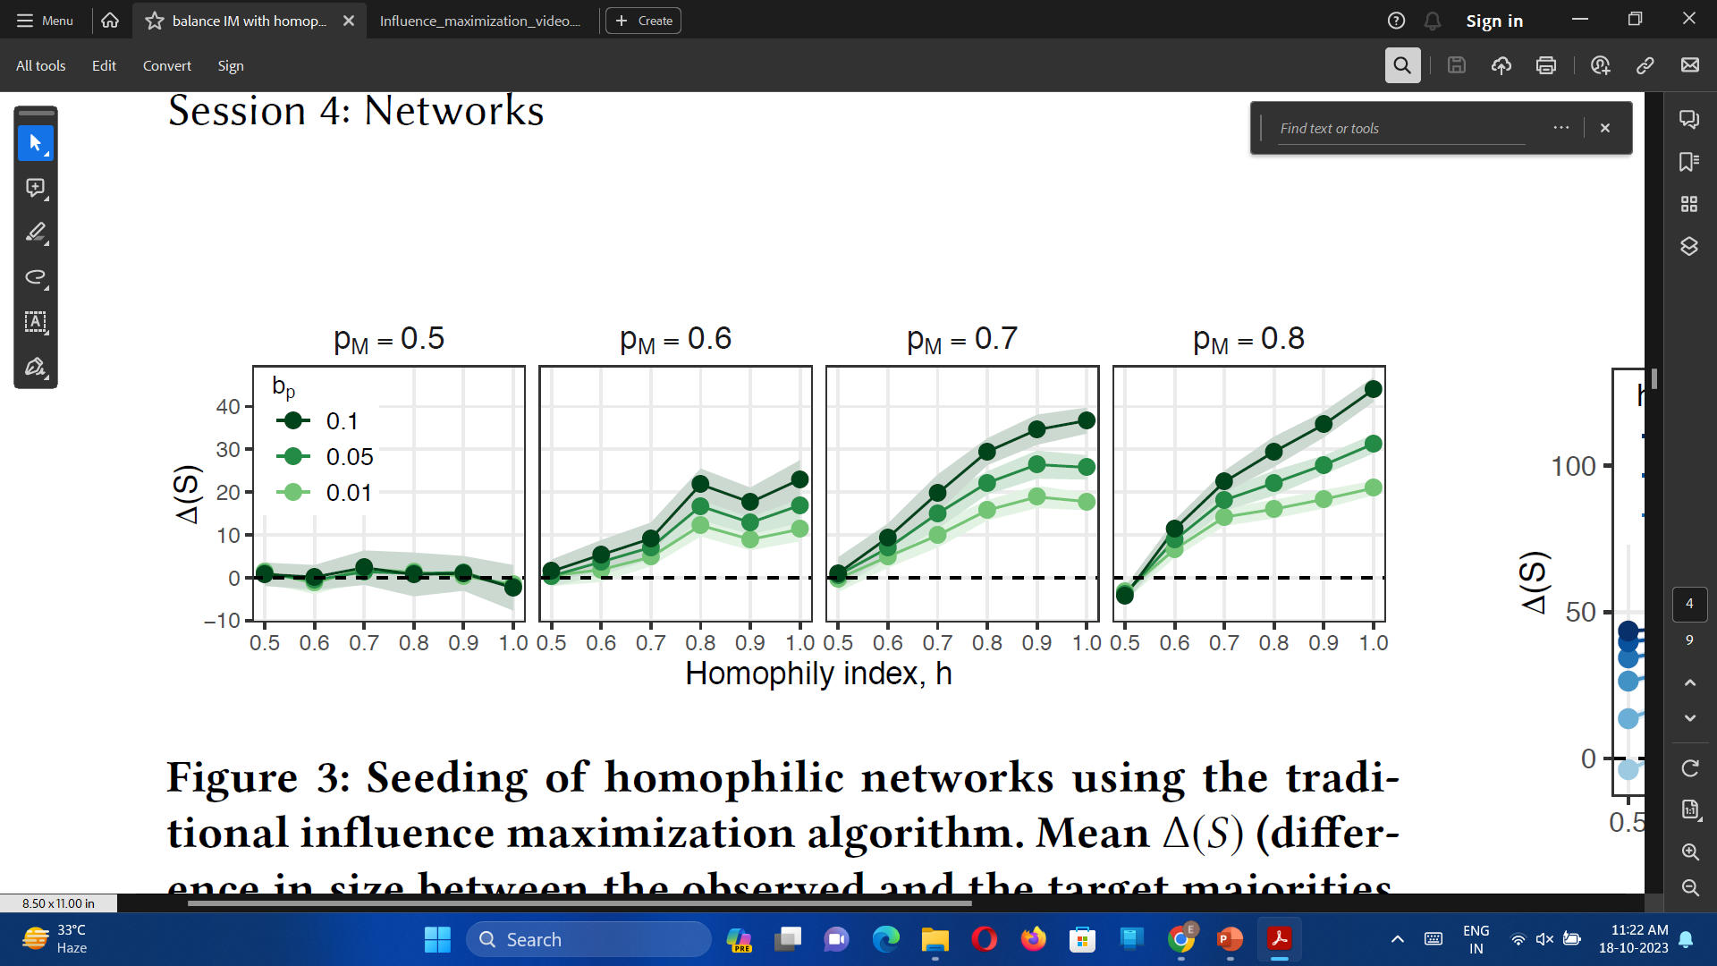
Homophily Vs

Slide 17
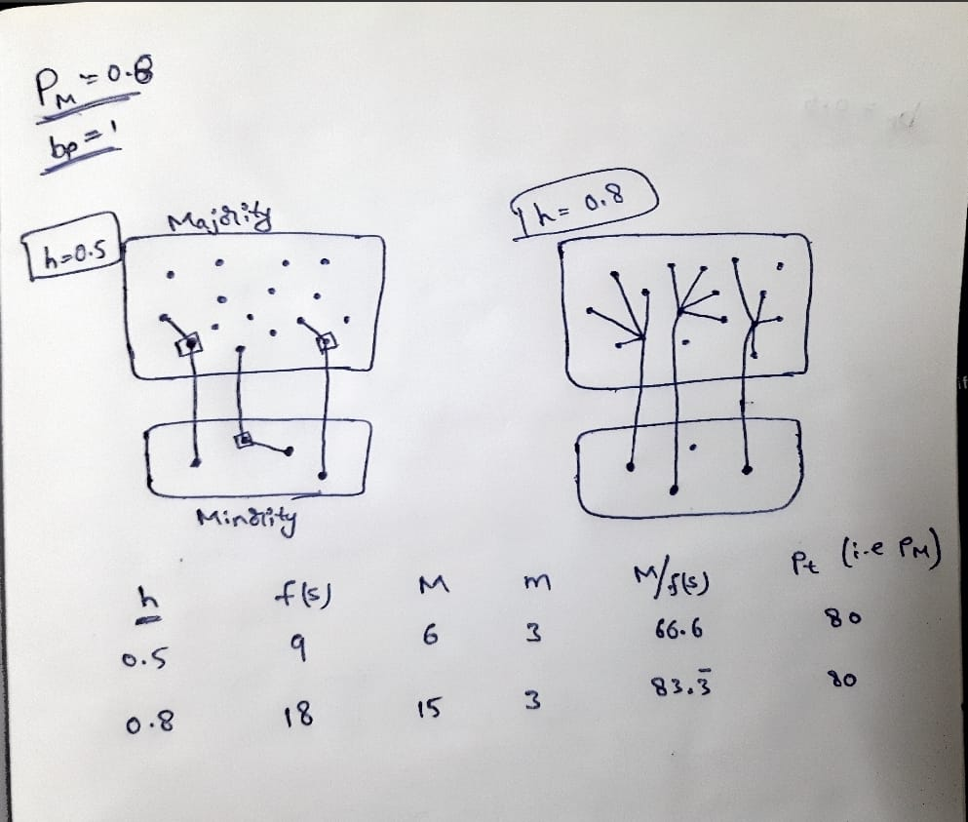
Homophily Vs

Slide 18
Balanced Influence Maximization Algorithm
The algorithm is designed to jointly maximize the influence and balance among nodes while still preserving the attractive theoretical guarantees of traditional influence maximization algorithms.In homophilic networks, where nodes tend to connect with similar others, traditional influence maximization algorithms can lead to imbalanced influence, favouring certain groups over others.
Balanced influence maximization aims to select seed nodes that spread influence fairly across different groups in the network. This is achieved by considering both structural homophily (how groups are connected) and diffusion homophily (how influence spreads within groups) during the selection process.
By selecting seeds that maximize influence within and across groups, balanced influence maximization ensures that all parts of the network are reached, leading to fairer and more inclusive outcomes.

Slide 19
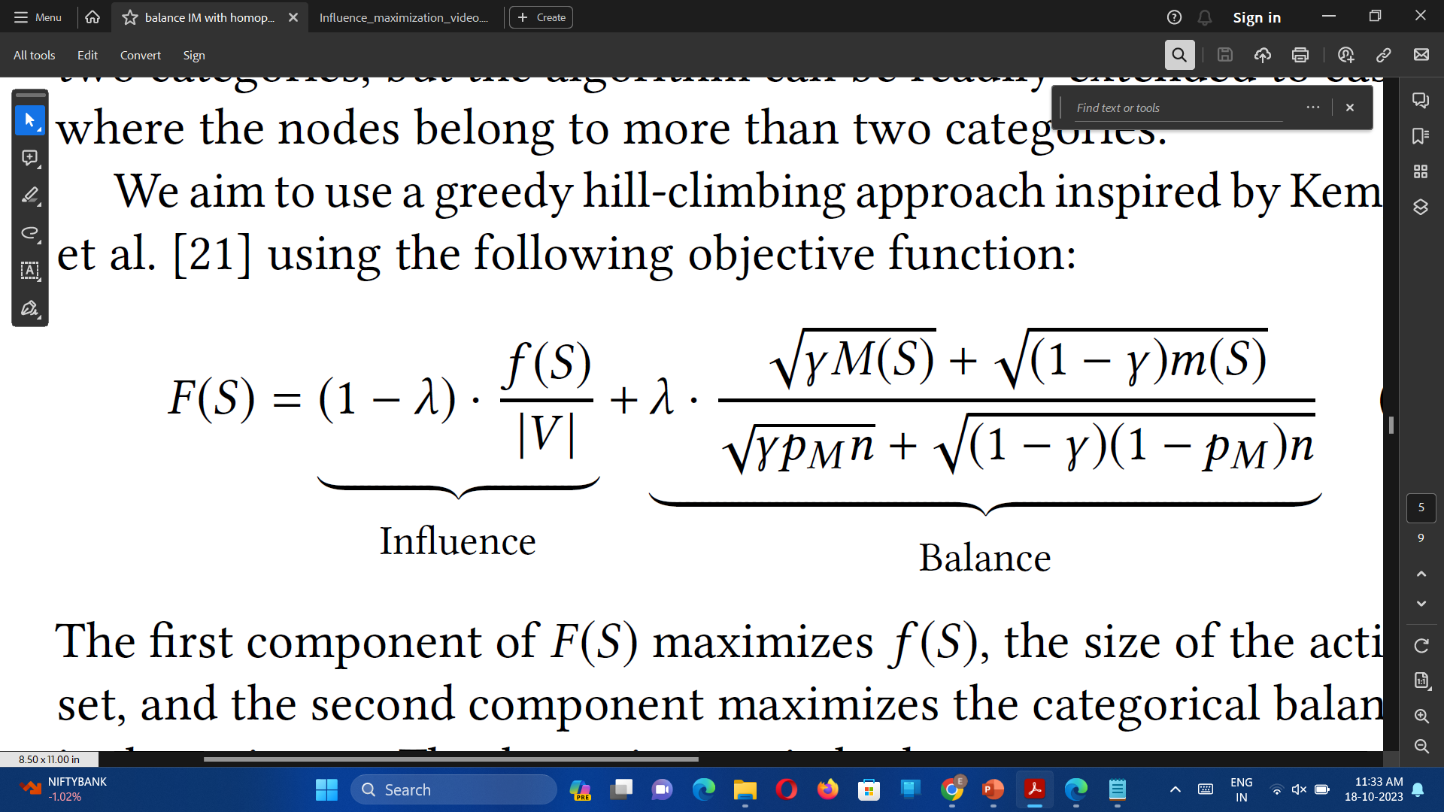
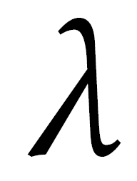
Trade off between Influence and balance
Pm The fraction of nodes in the majority group
M(S) Observed size of the majority in the active set
m(S) Observed size of the minority in the active set
f(S) Total number of nodes in the active set
|V| No of vertices
Parameter related to homophily
n Total number of nodes in the network

Slide 20
CELF(Cost Effective Lazy Forward)
CELF exploits the sub-modularity property of the spread function
Intuition:-
The Intuition of CELF is that the marginal spread of a given node in one iteration of the Greedy algorithm cannot be any larger than its marginal spread in the previous iteration
By submodularity property:
𝑓 𝑆_{𝑖} ∪ 𝑢 − 𝑓 𝑆_{𝑖} ≥ 𝑓 𝑆_{j} ∪ 𝑢 − 𝑓 𝑆_{j}
Observation: By submodularity:
For every 𝒖
𝛿_{𝑖}(𝑢) ≥ 𝛿_{j}(𝑢) for 𝑖 < 𝑗 since 𝑆_{𝑖} ⊂ 𝑆𝑗
for 𝑖 < 𝑗

Slide 21
There are 2 phases in CELF
1st round :- calculating the spread for all nodes (like Greedy) and store them in a list which is then sorted.
2nd round:-Re-evaluate δ_{i} only for top node
The second component iterates to find the remaining k−1 seed nodes. Within each iteration, the algorithm evaluates the marginal spread of the top node
Re-order and prune
In addition, it also returns the list lookups, which keeps track of how many spread calculations were performed at each iteration
By avoiding calculating the spread for many nodes, CELF turns out to be much faster than Greedy.
Time complexity of CELF :-
the overall time complexity is O(n * f + k * log n * f).

Slide 22
CELF++
Algorithm: CELF++
Require: G, k
Ensure: seed set S
1: S ← ∅; Q ← ∅; last seed = null; cur best = null.
2: for each u ∈ V do
3: u.mg1 = σ({u});
u.prev best = cur best;
u.mg2 = σ({u, cur best}); u.flag = 0.
Add u to Q. Update cur best based on mg1.
4: while |S| < k do
5: u = top (root) element in Q.
6: If u.flag == |S| then
7: S ← S ∪ {u};Q ← Q − {u};
last seed = u.continue;
10: else if u.prev best == last seed then
11: u.mg1 = u.mg2.
12: else
13: u.mg1 = Δu (S); u.prev best = cur best; u.mg2 =
Δu(S ∪ {cur best}).
14: u.flag = |S|; Update cur best.
15: Reinsert u into Q and heapify.
Terms
σ(S) - spread of seed set S.
Δu(S) - marginal gain of u w.r.t current seed set S
3. u.prev_best - node that has the maximum marginal gain among
all the nodes in the current iteration before node u
last_seed – the recent node which was added to the seed set S
Curr_best – Node which has highest marginal gain

Slide 23
Datasets
Karate Club:
It is a simple undirected graph with 34 nodes known as club members and 78 edges known as friendship ties. It is a common dataset often used as a benchmark for testing and comparing network analysis algorithms.
Erdős-Rényi random graph generator:
In this dataset, a graph with n nodes is generated by randomly adding edges between nodes with a certain probability p.
while performing this experiment a random graph is generated with 500 nodes and edge probability of 0.19. We obtained a graph with 100 nodes and 523 edges

Slide 24
Metrics:
Run-Time: Time taken by the algorithmic model to generate the seed set
DNI(Distant Nodes Influence): The number of activated nodes by the seed set

Slide 25
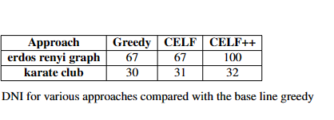
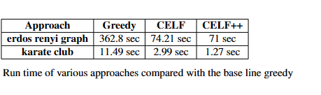
Results

Slide 26
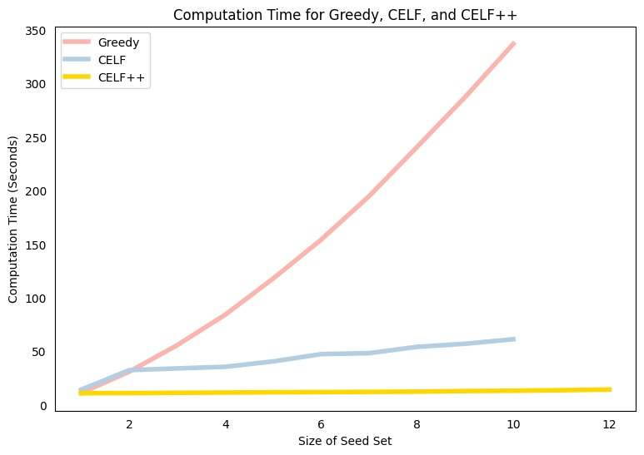
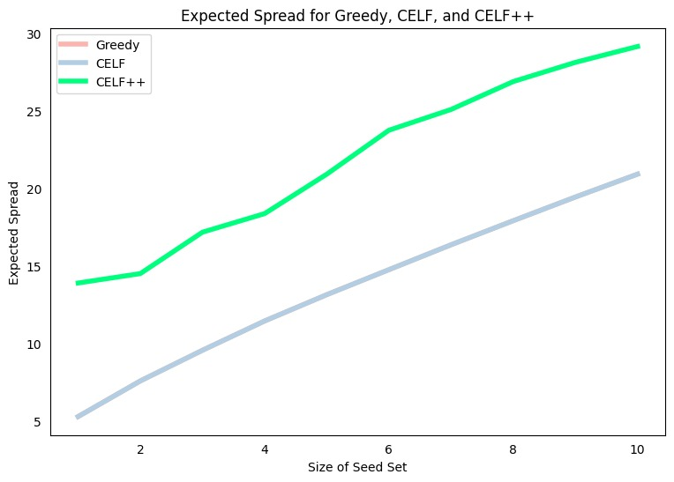
Graphs:

Slide 27
Conclusion and Future Scope
In this work we demonstrated the CELF and CELF++ performed very well compared to greedy in terms of run-time.
CELF and CELF++ did not show much difference in the spread compared to Greedy
We have integrated CELF and CELF++ directly on the given social network
To get the better efficiency in terms of spread, we will integrate CELF and CELF++ with the graph embeddings generated by the deep learning model

